Slide 1
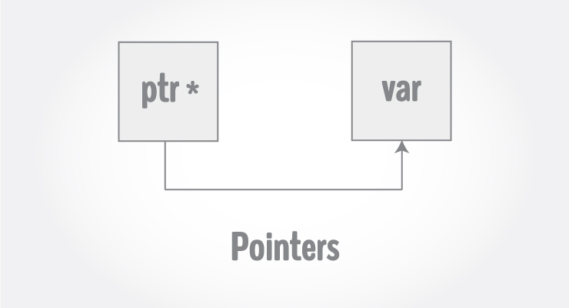
C Pointers

Slide 2
Every variable is a memory location and every memory location has its address defined which can be accessed using ampersand (&) operator, which denotes an address in memory
#include <stdio.h>
int main()
{
int var = 5;
printf("Value: %d\n", var);
printf("Address: %u", &var);
return 0;
}
Value: 5
Address: 2686778

Slide 3
What are Pointers?
A pointer is a variable whose value is the address of another variable, i.e., direct address of the memory location.
Syntax to declare a pointer variable
type *var-name;
Examples
int *ip; /* pointer to an integer */
double *dp; /* pointer to a double */
float *fp; /* pointer to a float */
char *ch /* pointer to a character */

Slide 4
How to Use Pointers?
(a) We define a pointer variable
(b) assign the address of a variable to a pointer
(c) finally access the value at the address available in the pointer variable. This is done by using unary operator * (dereferencing operator) that returns the value of the variable located at the address specified by its operand.

Slide 5
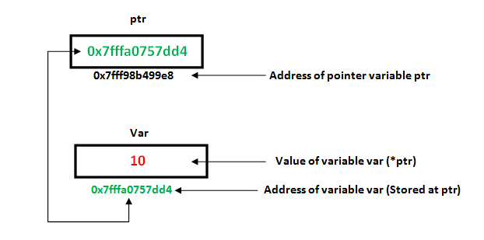

Slide 6
Using pointers to access address and value of a Variable
#include <stdio.h>
int main () {
int var = 20; /* actual variable declaration */
int *ip; /* pointer variable declaration */
ip = &var; /* store address of var in pointer variable*/
printf("Address of var variable: %x\n", &var );
/* address stored in pointer variable */
printf("Address stored in ip variable: %x\n", ip );
/* access the value using the pointer */
printf("Value of *ip variable: %d\n", *ip );
return 0;
}
Address of var variable : bffd8b3c
Address stored in ip variable : bffd8b3c
Value of *ip variable : 20

Slide 7
Changing the value of a variable through pointers
#include <stdio.h>
int main(){
int* pc;
int c;
c=22;
printf("Address of c:%u\n",&c);
printf("Value of c:%d\n\n",c);
pc=&c;
printf("Address of pointer pc:%u\n",pc);
printf("Content of pointer pc:%d\n\n",*pc);
c=11;
printf("Address of pointer pc:%u\n",pc);
printf("Content of pointer pc:%d\n\n",*pc);
*pc=2;
printf("Address of c:%u\n",&c);
printf("Value of c:%d\n\n",c);
return 0;
}
Address of c: 2686784
Value of c: 22
Address of pointer pc: 2686784
Content of pointer pc: 22
Address of pointer pc: 2686784
Content of pointer pc: 11
Address of c: 2686784
Value of c: 2

Slide 8
Pointer Analysis – Say Correct or Wrong
int c, *pc;
pc = c;
// Wrong! pc is address whereas, c is not an address.
*pc = &c;
// Wrong! *pc is the value pointed by address whereas, %amp;c is an address.
pc = &c;
// Correct! pc is an address and, %amp;pc is also an address.
*pc = c;
// Correct! *pc is the value pointed by address and, c is also a value.

Slide 9
NULL Pointers
It is always a good practice to assign a NULL value to a pointer variable in case you do not have an exact address to be assigned.
#include <stdio.h>
int main () {
int *ptr = NULL;
printf("The value of ptr is : %x\n", ptr );
return 0;
}
To check for a null pointer, you can use an 'if' statement as follows −
if(ptr) /* succeeds if p is not null */
if(!ptr) /* succeeds if p is null */

Slide 10
Pointer arithmetic – Incrementing/Decrementing a pointer
#include <stdio.h>
const int MAX = 3;
int main ()
{
int var[] = {10, 100, 200};
int i, *ptr;
/* let us have array address in pointer */
ptr = var;
for ( i = 0; i < MAX; i++) {
printf("Address of var[%d] = %x\n", i, ptr );
printf("Value of var[%d] = %d\n", i, *ptr );
ptr++;
}
return 0;
}
Address of var[0] = bf882b30
Value of var[0] = 10
Address of var[1] = bf882b34
Value of var[1] = 100
Address of var[2] = bf882b38
Value of var[2] = 200

Slide 11
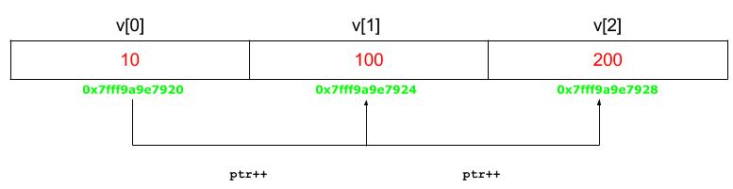

Slide 12
Pointer arithmetic –Pointer Comparisons
#include <stdio.h>
const int MAX = 3;
int main () {
int var[] = {10, 100, 200};
int i, *ptr;
/* let us have address of the first element in pointer */
ptr = var;
i = 0;
while ( ptr <= &var[MAX - 1] ) {
printf("Address of var[%d] = %x\n", i, ptr );
printf("Value of var[%d] = %d\n", i, *ptr );
ptr++;
i++;
}
return 0;
}
Address of var[0] = bfdbcb20
Value of var[0] = 10
Address of var[1] = bfdbcb24
Value of var[1] = 100
Address of var[2] = bfdbcb28
Value of var[2] = 200

Slide 13
Array of Pointers (working with integers)
#include <stdio.h>
const int MAX = 3;
int main () {
int var[] = {5, 10, 15};
int i, *ptr[MAX];
for ( i = 0; i < MAX; i++) {
ptr[i] = &var[i]; /* assign the address of integer. */
}
for ( i = 0; i < MAX; i++) {
printf("Value of var[%d] = %d\n", i, *ptr[i] );
}
return 0;
}
Value of var[0] = 5
Value of var[1] = 10
Value of var[2] = 15

Slide 14
C program to understand difference between pointer to an integer and pointer to an array of integers.
#include<stdio.h>
int main()
{
int *p;
int (*ptr)[5];
int *ip[5];
int arr[5]={1,2,3,4,5};
p = arr;
ptr = &arr;
printf("p = %p, ptr = %p\n", p, ptr);
p++;
ptr++;
printf("p = %p, ptr = %p\n", p, ptr);
return 0;
}

Slide 15
pointer to 1- D Array
// pointer of 1- D Array
#include<stdio.h>
int main()
{
int arr[5]={3,5,6,7,9};
int *p = arr;
int i;
for(i=0;i<=4;i++)
printf("%x %d\n", p+i,*p+i);
return 0;
}

Slide 16
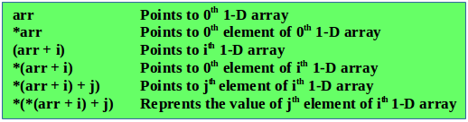
Pointer to 2-Array

Slide 17
Pointer to 2-Array
int nums[2][3] = { {16, 18, 20}, {25, 26, 27} };
In general, nums[i][j] is equivalent to *(*(nums+i)+j)
POINTER NOTATION | ARRAY NOTATION | VALUE
*(*nums) | nums[0][0] | 16
*(*nums + 1) | nums[0][1] | 18
*(*nums + 2) | nums[0][2] | 20
*(*(nums + 1)) | nums[1][0] | 25
*(*(nums + 1) + 1) | nums[1][1] | 26
*(*(nums + 1) + 2) | nums[1][2] | 27

Slide 18
Pointer to 2-D array
#include<stdio.h>
int main()
{
int arr[3][4] = {
{ 10, 11, 12, 13 },
{ 20, 21, 22, 23 },
{ 30, 31, 32, 33 }
};
int i, j;
for (i = 0; i < 3; i++)
{
printf("Address of %dth array = %d %d\n", i, arr[i], *(arr + i));
for (j = 0; j < 4; j++)
printf("%d %d ", arr[i][j], *(*(arr + i) + j));
printf("\n");
}
return 0;
}
http://www.geeksforgeeks.org/pointer-array-array-pointer/

Slide 19
#include<stdio.h>
int main()
{
int arr[3][4] = {{10, 11, 12, 13},
{20, 21, 22, 23},
{30, 31, 32, 33}};
int (*ptr)[4];
ptr = arr;
printf("%p %p %p\n\n", ptr, ptr + 1, ptr + 2);
printf("%p %p %p\n", *ptr, *(ptr + 1), *(ptr + 2));
printf("%d %d %d\n", **ptr, *(*(ptr + 1) + 2), *(*(ptr + 2) + 3));
printf("%d %d %d\n", ptr[0][0], ptr[1][2], ptr[2][3]);
return 0;
}

Slide 20
Char array without using pointer and with Pointers
char name[3][20] = {
"Adam",
"chris",
"Deniel"
};
char *name[3] = {
"Adam",
"chris",
"Deniel"
};

Slide 21
Pointers to an String Array
#include <stdio.h>
const int MAX = 4;
int main () {
char *names[] = {
"Zara Ali",
"Hina Ali",
"Nuha Ali",
"Sara Ali",
};
int i = 0;
for ( i = 0; i < MAX; i++) {
printf("Value of names[%d] = %s\n", i, names[i] );
}
return 0;
}
Value of names[0] = Zara Ali
Value of names[1] = Hina Ali
Value of names[2] = Nuha Ali
Value of names[3] = Sara Ali

Slide 22
Pointers to Arrays (working with strings)
#include<stdio.h>
#include<conio.h>
main()
{
char *a[]={"VIT","VELLORE","UNIVERSITY"};
int i,j;
for(i=0;i<3;i++)
{
printf("%s\t%s\t%c\n",a[i],*(a+i),*(a[1]+2));
printf("%c\t%c\n",*(a[0]+1),*(a[2]+4));
}
getch();
}

Slide 23
Pointer to functions
#include <stdio.h>
/* function declaration */
double getAverage(int *arr, int size);
int main () {
/* an int array with 5 elements */
int balance[5] = {1000, 2, 3, 17, 50};
double avg;
/* pass pointer to the array as an argument */
avg = getAverage( balance, 5 ) ;
/* output the returned value */
printf("Average value is: %f\n", avg );
return 0;
}
double getAverage(int *arr, int size) {
int i, sum = 0;
double avg;
for (i = 0; i < size; ++i) {
sum += arr[i];
}
avg = (double)sum / size;
return avg;
}

Slide 24
Pointers to functions(Palindrome)
#include<stdio.h>
int main()
{
char string[20];
printf("Enter the string ::");
gets(string);
if( Ispalindrome(string))
printf("\n %s is a palindrome\n", string);
else
printf("\n %s is not a palindrome\n" ,string);
system("pause");
}
int Ispalindrome(char* str)
{
int i, len;
len = strlen(str);
for(i = 0; i < len / 2; i++)
{
if( *(str +i ) != *(str + len - i - 1) )
return 0;
}
return 1;
}

Slide 25
Return pointer from functions in C
#include <stdio.h>
#include <time.h>
/* function to generate and return random numbers. */
int * getRandom( ) {
static int r[10];
int i;
for ( i = 0; i < 5; ++i) {
r[i] = rand();
printf("%d\n", r[i] );
}
return r;
}
/* main function to call above defined function */
int main () {
/* a pointer to an int */
int *p;
int i;
p = getRandom();
for ( i = 0; i < 5; i++ ) {
printf("*(p + [%d]) : %d\n", i, *(p + i) );
}
return 0;
}

Slide 26

Pointer to Pointer
A pointer to a pointer is a form of multiple indirection, or a chain of pointers.
Example
int **var;

Slide 27
Pointer to Pointer - Example
#include <stdio.h>
int main () {
int var;
int *ptr;
int **pptr;
var = 3000;
/* take the address of var */
ptr = &var;
/* take the address of ptr using address of operator & */
pptr = &ptr;
/* take the value using pptr */
printf("Value of var = %d\n", var );
printf("Value available at *ptr = %d\n", *ptr );
printf("Value available at **pptr = %d\n", **pptr);
return 0;
}
Value of var = 3000
Value available at *ptr = 3000
Value available at **pptr = 3000

Slide 28
